Slide 1
Fixed income
Module1 Fixed-Income Securities : Defining Elements
Module2 Fixed-Income Markets : Issuance, Trading, and Funding
Module3 Introduction to Fixed-Income Valuation
Module4 Introduction to Asset-Backed Securities
Module5 Understanding Fixed-Income Risk and Return
Module6 Fundamentals of Credit Analysis

Slide 2
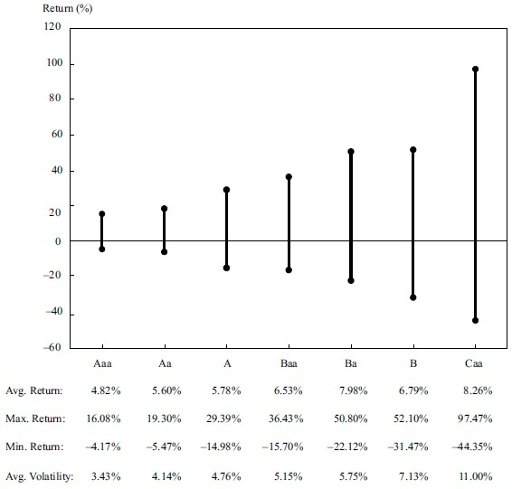
Fundamentals of credit analysis
CREDIT RISK VS. RETURN: YIELDS AND SPREADS
Note that the lower the credit quality, the higher the quoted yield.
The higher the credit risk, the greater the return potential and the higher the volatility of that return.

Slide 3
Fundamentals of credit analysis
Spreads on all corporate bonds can be affected by a number of factors, with lower-quality issuers typically experiencing greater spread volatility.
Credit cycle
Broader economic conditions
Funding availability in financial sector
General market supply and demand
Financial performance of the issuer

Slide 4
practices
1. Which bonds are likely to exhibit the greatest spread volatility?
A. Bonds from issuers rated AA
B. Bonds from issuers rated BB
C. Bonds from issuers rated A
2. If investors become increasingly worried about the economy—say, as shown by declining stock prices—what is the most likely impact on credit spreads?
A. There will be no change to credit spreads. They aren’t affected by equity markets.
B. Narrower spreads will occur. Investors will move out of equities into debt securities.
C. Wider spreads will occur. Investors are concerned about weaker creditworthiness.

Slide 5
Fundamentals of credit analysis
Credit Risk vs. Return: The Price Impact of Spread Changes
Based on credit analysis, an investor might be confident that an issuer’s risk of default is relatively low in the near term; however, looking many years into the future, the investor’s uncertainty grows because of factors that are increasingly difficult, if not impossible, to forecast.

Slide 6
Fundamentals of credit analysis
HIGH-YIELD, SOVEREIGN, AND NON-SOVEREIGN CREDIT ANALYSIS
High Yield
Greater focus on issuer liquidity and cash flow
Detailed financial projections
Detailed understanding and analysis of the debt structure
Understanding of an issuer’s corporate structure
Covenants
Equity-like approach to high-yield analysis

Slide 7
Fundamentals of credit analysis
Thus, issuer liquidity is a key focus in high-yield analysis. Sources of liquidity, from strongest to weakest, are the following:
1. Cash on the balance sheet
2. Working capital
3. Operating cash flow
4. Bank credit facilities
5. Equity issuance
6. Asset sales

Slide 8
Fundamentals of credit analysis
Key covenants for high-yield issuers may include the following:
■ Change of control put
■ Restricted payments
■ Limitations on liens and additional indebtedness
■ Restricted versus unrestricted subsidiaries

Slide 9
Fundamentals of credit analysis
SOVEREIGN
■ Institutional assessment
■ Economic assessment
■ External assessment
■ Fiscal assessment
■ Monetary assessment

Slide 10
Fundamentals of credit analysis
NON-SOVEREIGN
General obligation (GO) bonds are unsecured bonds issued with the full faith and credit of the issuing non-sovereign government. These bonds are supported by the taxing authority of the issuer. Revenue bonds are issued for specific project financing.
US municipalities must balance their operating budgets (i.e., exclusive of long-term capital projects) annually.
A key credit measure for revenue-backed non-sovereign government bonds is the debt-service-coverage (DSC) ratio

Slide 11
practices
Which of the following factors in credit analysis is more important for general obligation non-sovereign government debt than for sovereign debt?
A. Per capita income
B. Power to levy and collect taxes
C. Requirement to balance an operating budget
Which of the following factors would best justify a decision to avoid investing in a country’s sovereign debt?
A. Freely floating currency
B. A population that is not growing
C. Suitable checks and balances in policymaking

